Slide 1
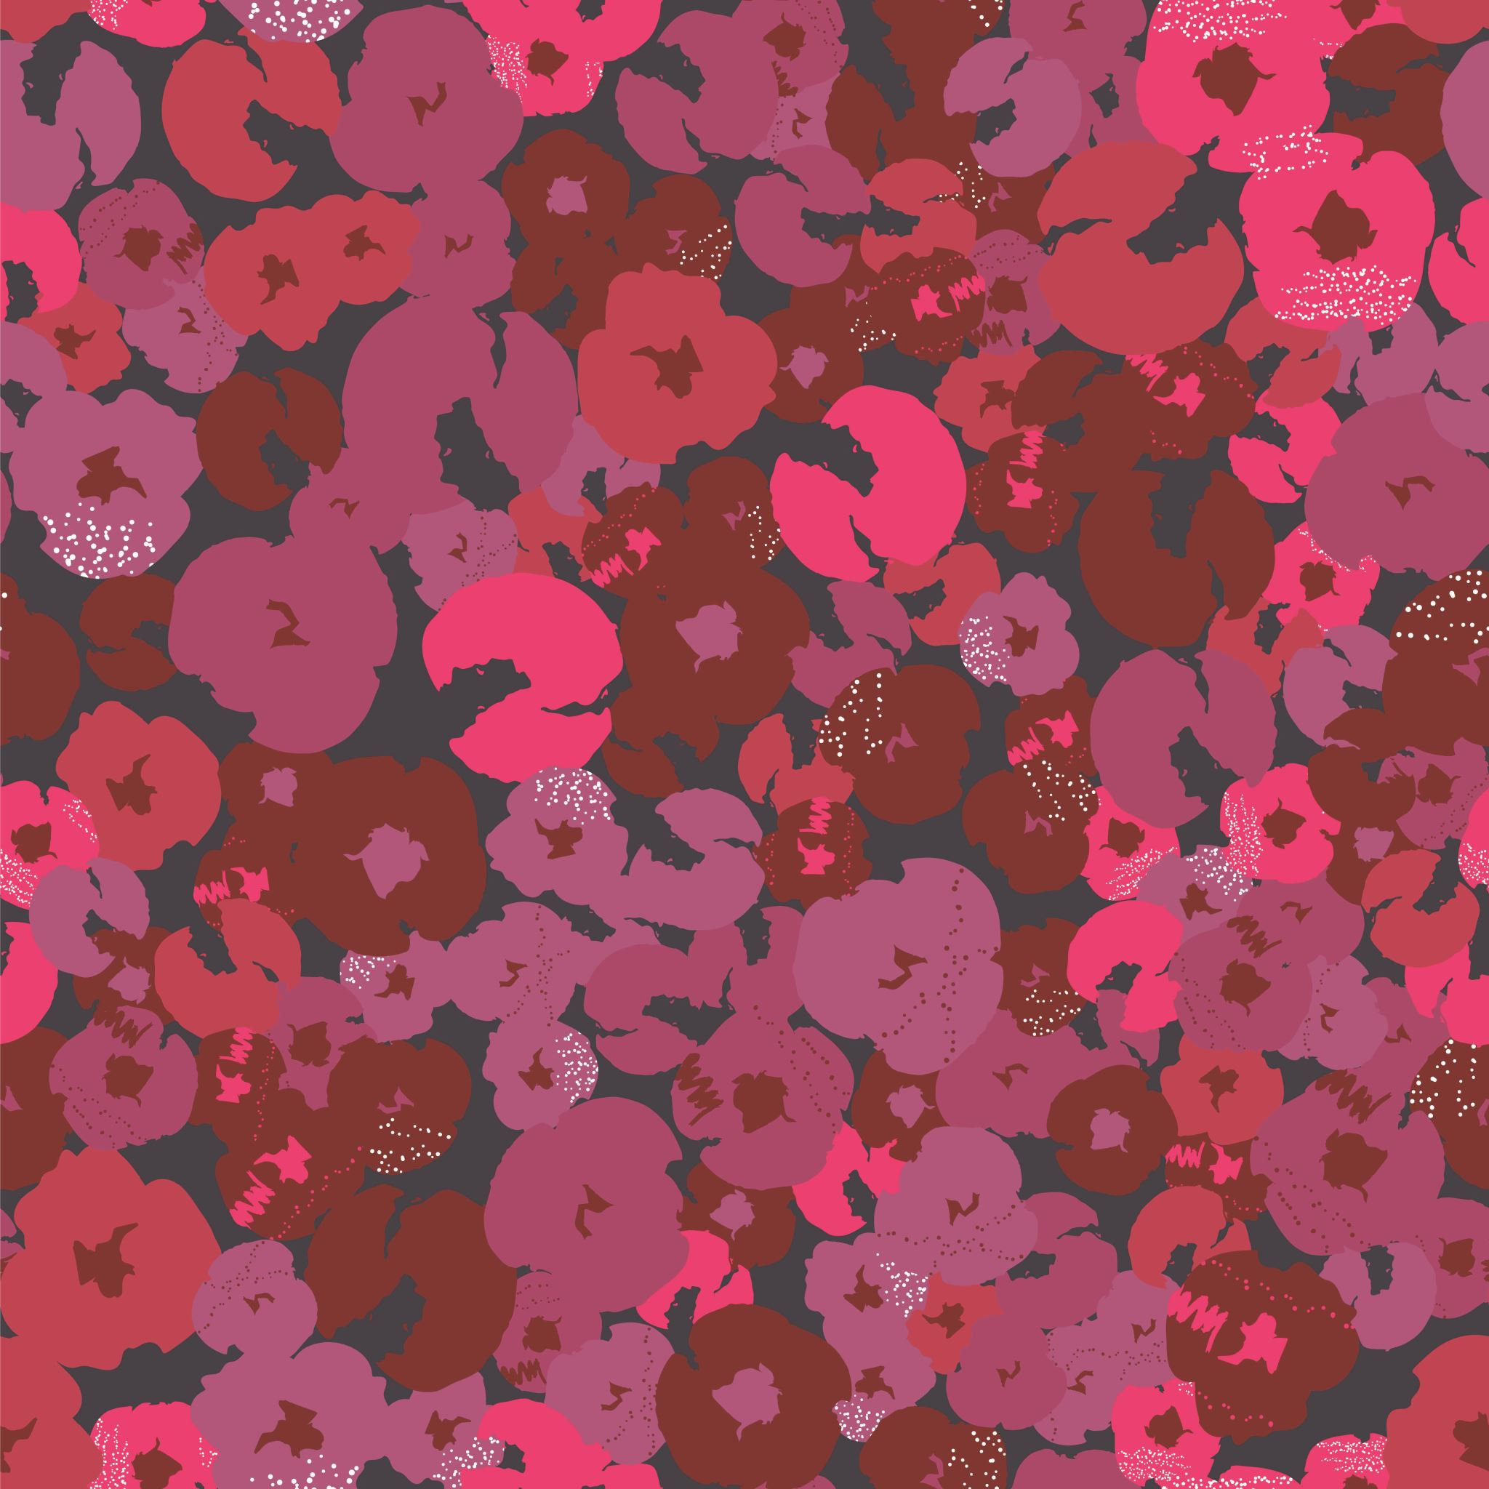
CS 6366 Final Project Implementing Volume Lighting with Shadows using half angle slicing
–Srivastchavan Rengarajan (sxr190067)

Slide 2
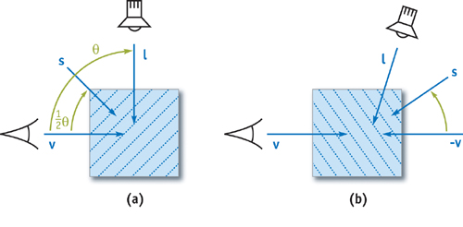
Problem summary –
In this project I am trying to implement real time
volume lighting and shadows using half angle slicing algorithm.
Volume lighting and shadow can be implemented with help of half angle slicing method. This method uses a pixel buffer to accumulate the amount of light attenuated from the light’s point of view. To achieve this the slicing axis is set halfway between the view and light direction vectors. This allows the same slice to be rendered from the eye’s and light’s point of view. The amount of light arriving at a particular slice is equal to 1 minus the accumulated opacity of the previously rendered slices. Each slice is first rendered from the eye's point of view, using the results of the previous pass rendered from the light's point of view, which are used to modulate the brightness of samples in the current slice. The same slice is then rendered from the light's point of view to calculate the intensity of the light arriving at the next slice.
Fig-1

Slide 3
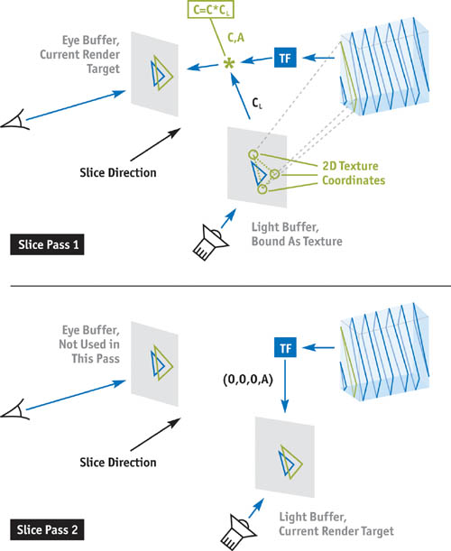
Two Pass Volume Rendering Algorithm
Pass 1: Render and blend the slice into the eye buffer.
Project the slice vertices to the light buffer using the light's modelview and projection matrices. Convert the resulting vertex positions to 2D texture coordinates based on the size of the light's viewport and the light buffer.
Bind the light buffer as a texture to an available texture unit and use the texture coordinates computed in step 3(a)(i). Recall that a set of 3D texture coordinates is also needed for the data texture lookup.
In the fragment shader, evaluate the transfer function for reflective color C and opacity A. Next, multiply C by the color from the light buffer C_{L} , and blend C and A into the eye buffer using the appropriate operator for the current slice direction.
Pass 2: Render and blend the slice into the light buffer using the Over operator. In the fragment shader, evaluate the transfer function for the alpha component and set the fragment color to 0.
Fig-2

Slide 4
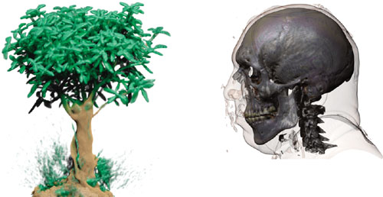
Examples of Volume Rendering with Shadows
Fig-3

Slide 5
Application of Volumetric Lighting and Shadows -
The direct volume rendering and lighting is widely used in visualization applications.
It is also used in various domains in biomedical and engineering disciplines.
Volumetric lighting and shadows are also most commonly used in the entertainment industry. Many of the recent big titles in the video games industry and most movie special effects use the volumetric rendering techniques extensively.
It is used for visualizing 3d datasets with high quality special effects with help of shadows generated by volumetric lighting. It can also be used in analysis of medical images.
Volumetric shadows greatly improve the realism of a rendered scene; hence they are used for photo realistic image rendering applications. It is also used to create visible light volume effects such as spotlights at concerts, car headlights and flashlights in dark room. The search for more and more real time photo realistic rendering makes the understanding and implementation of volumetric lighting and shadows an interesting topic.

Slide 6
Steps taken to complete openGL coding for volumetric lighting and shadow –
1. Setup offscreen rendering using FBO (both light buffer and eye buffer)
2. Load Volume Data from .raw file
3. Calculate Shadow matrix by multiplying the model view and projections matrices of light with bias matrix.
4. Calculate halfway vector using light direction and view direction. Slice the Volume data in the direction which is halfway between the view and light vectors
5. After binding the FBO, first clear the light buffer with white color and then eye buffer with black color.
6. Bind the volume VAO and then run a loop for the total number of slices. In each iteration, first render the slice in the eye buffer but bind the light buffer as the texture. Next, render the slice in the light buffer:
7. Based on the viewer direction, swap the blend function in the eye buffer rendering.
8. For light buffer, blend the slices using the conventional over blending method.
9. Finally, unbind the FBO and restore the default draw buffer. Next, set the viewport to the entire screen and then render the eye buffer on screen using a shader:

Slide 7
Results –
Volumetric lighting and shadows implementation was successfully completed using the half angle slicing technique. The steps involved and half angle slicing concept is thoroughly reviewed and studied from various sources and books which helped in completing the project successfully. Using freeGLUT the user interface is created which helps to rotate the object as well as move the light with help of left and right click of mouse. GLSL Shaders are implemented to shade and render the output. Grid Lines are drawn to give perspective the scene.
The results can be seen in the below images. Fig-5 below, shows the final rendering of Teapot.raw file with volumetric shadows. Fig-6 shows the colored teapot with shadows whereas Fig-7 and 8 show same teapot with low number of slices showing the lobster inside the teapot. The shadow of lobster can also be viewed in these images.

Slide 8
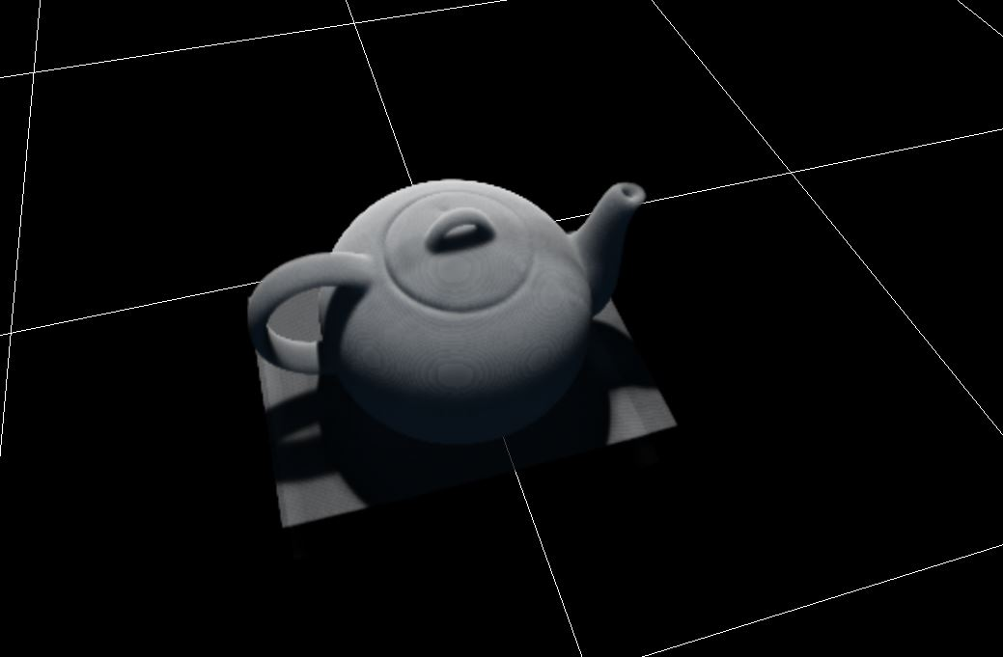
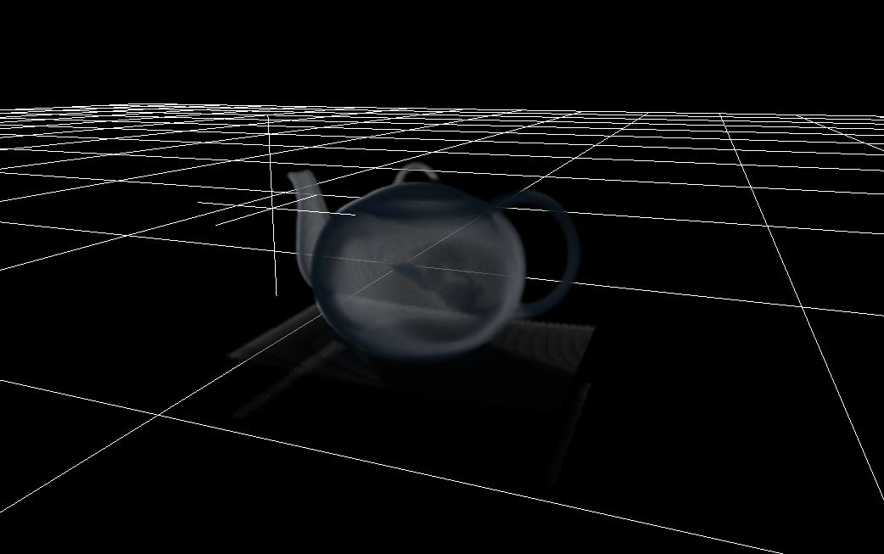
Fig-4
Fig-5

Slide 9
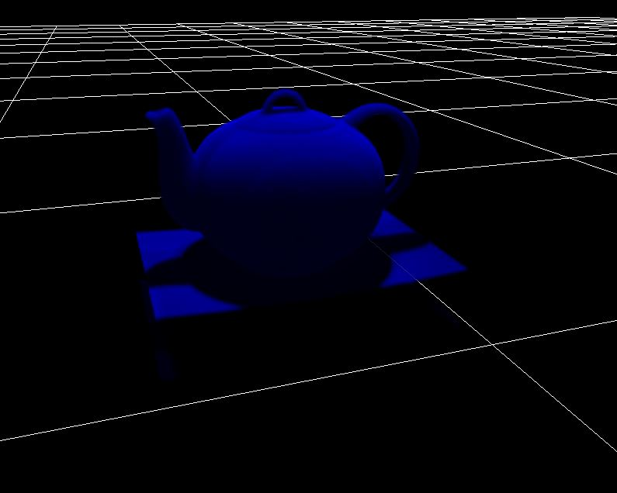
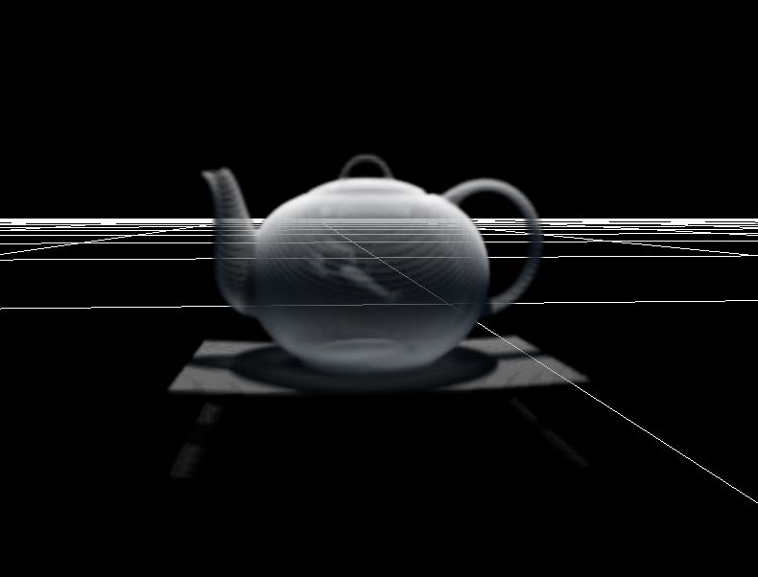
Fig-6
Fig-7

Slide 10
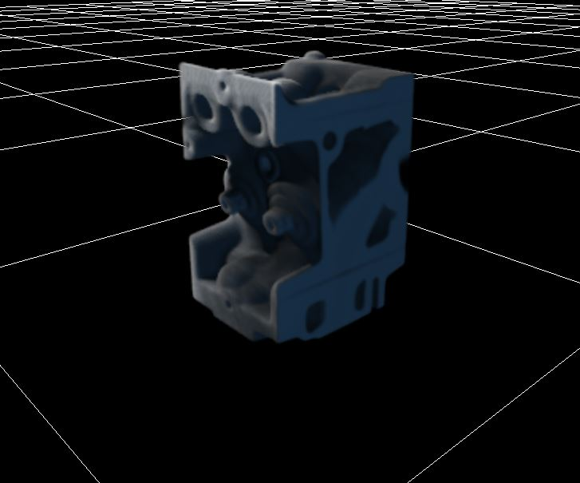
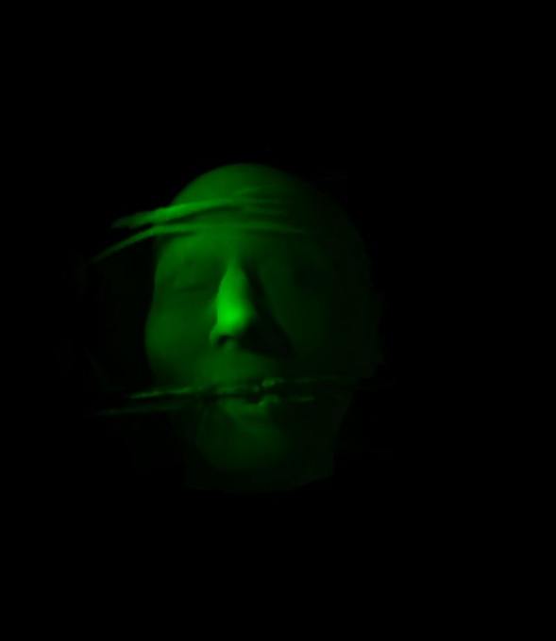
Fig-8
Fig-9

